Slide 1
Sometimes Russian is More Perfective Than Spanish
Laura A. Janda and Antonio Fábregas

Slide 2
Aspect in Spanish and Russian
Spanish
Tense outranks Aspect
Perfective vs. Imperfective only in Past tense forms
Russian
Aspect outranks Tense
Perfective vs. Imperfective in all forms
Spanish and Russian
Share a Perfective vs. Imperfective distinction only in Past tense forms
This research focuses only on Spanish Past tense forms and their Russian translation equivalents

Slide 3
Usually Russian and Spanish have the same aspect (opening lines of La Sombra del Viento by Carlos Ruíz Zafón 2001)
Todavía recuerdo aquel amanecer en que mi padre me llevó-pfv por primera vez a visitar el Cementerio de los Libros Olvidados. Desgranaban-ipfv los primeros días del verano de 1945 y caminábamos-ipfv por las calles de una Barcelona atrapada bajo cielos de ceniza y un sol de vapor que se derramaba-ipfv sobre la Rambla de Santa Mónica en una guirnalda de cobre líquido.
Я как сейчас помню то раннее утро, когда отец впервые повел-pfv меня на Кладбище Забытых Книг. Стояли-ipfv первые дни лета 1945 года. Мы шли-ipfv по улицам Барселоны, накрытой пепельным небом, и мутное солнце жидкой медью растекалось-ipfv по бульвару Санта-Моника.
‘I still remember the day my father took me to the Cemetery of Forgotten Books for the first time. It was the early summer of 1945, and we walked through the streets of a Barcelona trapped beneath ashen skies as dawn poured over Rambla de Santa Monica in a wreath of liquid copper.’

Slide 4
Usually Russian and Spanish have the same aspect, but not always
Spanish Perfective ≈ Russian Imperfective
Leyó-pfv toda la noche
Он читал-ipfv всю ночь
‘He read all night’
Approx 17%-22% of Spanish Perfectives correspond to Russian Imperfectives
Spanish Imperfective ≈ Russian Perfective
El mendigo se reía-ipfv de puro placer
Нищий рассмеялся-pfv от удовольствия
‘The beggar started laughing from pleasure’
Approx 8% of Spanish Imperfectives correspond to Russian Perfectives

Slide 5
Usually Russian and Spanish have the same aspect, but not always
Spanish Perfective ≈ Russian Imperfective
Leyó-pfv toda la noche
Он читал-ipfv всю ночь
‘He read all night’
Approx 17%-22% of Spanish Perfectives correspond to Russian Imperfectives
Spanish Imperfective ≈ Russian Perfective
El mendigo se reía-ipfv de puro placer
Нищий рассмеялся-pfv от удовольствия
‘The beggar started laughing from pleasure’
Approx 8% of Spanish Imperfectives correspond to Russian Perfectives
Sometimes Spanish and Russian choose opposite aspects
FOR THE SAME REASON!

Slide 6
Overall idea: Spanish views events externally Russian views events internally
1.
Spanish is more Perfective than Russian
Spanish views events externally
Any time period that is closed can motivate Perfective
Only the closing boundary counts to motivate Perfective
Russian views events internally
Any time period with duration can motivate Imperfective
Any boundary, including an initial boundary can motivate Perfective
2.
Russian is more Perfective than Spanish

Slide 7
Two datasets
Sombra:
La Sombra del Viento (Zafón 2001) and translation Тень ветра (2016)
967 Spanish Past Perfective forms and 967 Spanish Past Imperfective forms, plus the Russian translation equivalents of those
RNC:
Spanish-Russian portion of the Russian National Corpus
373 Spanish Past Perfective forms and 528 Spanish Past Imperfective forms, plus the Russian translation equivalents of those
All verbs in both languages were aligned and parsed by hand.

Slide 8
1. Spanish is more Perfective than Russian
 |  | La Sombra del Viento sample (Sombra) | Russian National Corpus Spanish parallel corpus sample (RNC)
Spanish pst.pfv | Total Spanish pst.pfv | 100% (967) | 100% (373)
 | > Russian pfv-pst | 74.4% (719) | 55.5% (207)
 | > other Russian pfv | 2.1% (20) | 7.5% (28)
 | > Russian ipfv-pst | 11.1% (107) | 18.5% (69)
 | > other Russian ipfv | 1.6% (15) | 3.5% (13)
 | > no verb in Russian | 11% (106) | 16.1% (60)
Aspectual mismatch when
Spanish Perfective ≈ Russian Imperfective

Slide 9
When does Spanish Perfective ≈ Russian Imperfective?
Time periods filled with an event
Repetitions
Time until
Inferred temporal boundaries
Historical present
Other factors

Slide 10
When does Spanish Perfective ≈ Russian Imperfective?
Time periods filled with an event
Repetitions
Time until
Inferred temporal boundaries
Historical present
Other factors

Slide 11
Spanish Perfective ≈ Russian Imperfective Time periods filled with an event
Spanish prefers Perfective if a time period is named, because the event can be seen from without as a closed package
Russian prefers Imperfective if a time period is named, because the event can be seen from within as a duration
Esta es la historia de cómo uno de los hombres más poderosos de la Francia medieval asesinó-pfv impunemente durante décadas por pura diversión
Это история о том, как один из самых могущественных людей средневековой Франции в течении десятилетий безнаказанно убивал-ipfv исключительно ради развлечения
‘This is the story of how one of the most powerful men in medieval France over the course of decades murdered with impunity just for amusement’ [César Cervera. (2017.01.18)]

Slide 12
Spanish Perfective ≈ Russian Imperfective Repetitions
Spanish can view repetitions from without focusing on the boundary using Perfective
Russian typically views repetitions from within using Imperfective
Tres veces intenté-pfv seguir una ruta que había creído memorizar, y tres veces me devolvió-pfv el laberinto al mismo punto del que había partido. [S98:25]
Трижды пытался-ipfv я пройти путем, который, как мне казалось, помнил, и трижды лабиринт возвращал-ipfv меня на точку старта. [R82:62]
‘Three times I tried to follow a path I thought I had memorized, and three times the maze returned me to the same point.’

Slide 13
Spanish Perfective ≈ Russian Imperfective Time until
Spanish hasta ‘until’ focuses on the endpoint of a time period with Perfective
Russian пока не ‘until’ focuses on the duration with Imperfective
Neri… hurgó-pfv en mis bolsillos hasta dar con las llaves. [S83:35]
Нери… шарил-ipfv по моим карманам, пока не нашел ключи. [R67:2]
‘Neri… rummaged in my pockets until he found the keys.’

Slide 14
Spanish Perfective ≈ Russian Imperfective Inferred temporal boundaries
Spanish can use Perfective when the final boundary is inferred (here because we know that a lifetime is finite), not overtly stated
Russian focuses on the duration with Imperfective
En palabras de la arqueóloga… una de las personas enterradas (la mujer) tuvo-pfv cifosis
По словам археолога… одно из захороненных тел принадлежало женщине, которая при жизни страдала-ipfv кифозом
‘In the words of the archeologist… one of the people who were buried (the woman) had kyphosis’ [Media [www.abc.es] (2016.12.19)]

Slide 15
Spanish Perfective ≈ Russian Imperfective Inferred temporal boundaries
Spanish inference of boundaries also with adverb siempre ‘always’ can trigger Perfective
Russian use of всегда ‘always’ usually with Imperfective
yo siempre le tuve-pfv por un sinvergüenza. [S95:16]
я его всегда держал-ipfv за бессовестную скотину. [R79:38]
‘To me he was always a scoundrel.’

Slide 16
Spanish Perfective ≈ Russian Imperfective Historical present
Russian Imperfective Historical Present can correspond to Spanish Past Perfective
Celestino dio-pfv una vuelta, tenía la boca seca. La fuerza empezó-pfv a desdibujarse, a hacerse un poco confusa… Celestino Ortiz se levantó-pfv de su jergón, encendió-pfv la luz del bar, tomó-pfv un traguito de sifón y se metió-pfv en el retrete.
Селестино поворачивается-ipfv, во рту у него пересохло. Очертания отряда начинают-ipfv расплываться, заволакиваться туманом… Селестино Ортис поднимается-ipfv со своего матраса, включает-ipfv свет, отпивает-ipfv глоток из сифона и идет-ipfv в уборную.
‘Celestino turned around, his mouth was dry. The troops began to dissolve, to become rather hazy... Celestino Ortiz got up off of his mattress, turned on the light, took a swallow from the tap, and went to the bathroom.’ [Camilo José Cela. (1951)]

Slide 17
Spanish Perfective ≈ Russian Imperfective Other factors: language-specific facts
Some Russian Imperfective verbs lack a Perfective partner verb of the same lexical meaning: быть ‘be’, мочь ‘can’
Cuál fue-pfv su sorpresa cuando, cientos de kilómetros más tarde, descubrió que... [S42:14]
Kakovo že bylo-ipfv ego udivlenie, kogda, proexav sotni kilometrov, on obnaružil, čto... [R26:28]
‘Much to his surprise, hundreds of kilometers later, he discovered...’

Slide 18
Spanish Perfective ≈ Russian Imperfective Other factors: language-specific facts
Russian prefers Imperfective verbs with manner adverbs, since the adverb turns the attention to the inner structure of an event and how it unfolds
Rusia luchó-pfv duramente contra turcos, franceses e ingleses para mantener Crimea.
Россия ожесточенно боролась-ipfv с турками, французами и англичанами за обладание Крымом.
‘Russia fought ferociously against the Turks, the French, and the English to maintain control of the Crimea.’ [Francisco López-Seivane. (2016.10.24)]

Slide 19
Spanish Perfective ≈ Russian Imperfective Other factors: language-specific facts
Categorical negation requires Imperfective in Russian, but not in Spanish.
después de aquel día, Nuria nunca más volvió-pfv a saber de Carax [S96:1]
с тех пор Нурия никогда ничего не слышала-ipfv о Караксе [R80:32]
‘after that day Nuria didn’t hear from Carax again’

Slide 20
Spanish Perfective ≈ Russian Imperfective Other factors: language-specific facts
Russian general-factual Imperfective corresponds to Spanish Perfective
Me acuerdo hasta de la cara de una gitana que nos leyó-pfv la mano en la playa del Bogatel [S97:58]
Я даже помню лицо цыганки, которая гадала-ipfv нам по руке на пляже Богатель [R82:21]
‘I even remember the face of a Gypsy woman who read our fortune on El Bogatell beach’

Slide 21
Spanish Perfective ≈ Russian Imperfective Other factors: language-specific facts
Russian prefers Imperfective for “annulled events”, corresponding to Spanish Perfective
Sé que una vez, en el 32 o el 33, Nuria viajó-pfv a París por asuntos de Cabestany, y que se alojó-pfv en casa de Julián Carax un par de semanas. [S94:46]
Знаю, что однажды, в 1932-м или в 1933-м, она ездила-ipfv в Париж по делам Кабестаня и останавливалась-ipfv на пару недель у Хулиана Каракса. [R78:64]
‘I know that once, in 1932 or 1933, Nuria went to Paris on business for Cabestany, and she stayed in Julián Carax’s apartment for a couple of weeks.’

Slide 22
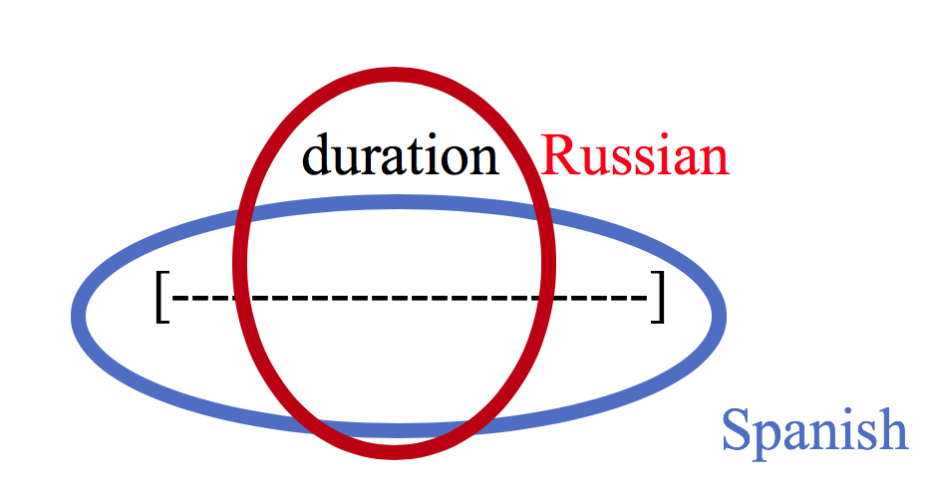
Spanish Perfective ≈ Russian Imperfective Summary
The Spanish pfv = Russian ipfv mismatch indicates a difference in the way that time periods are conceptualized in the two languages. In Spanish, time periods are typically seen as if from without, comparable to Langacker’s (2008:65) “maximal scope”, whereas in Russian, time periods are typically seen from within, comparable to “immediate scope”.

Slide 23
2. Russian is more Perfective than Spanish
 |  | La Sombra del Viento sample (Sombra) | Russian National Corpus Spanish parallel corpus sample (RNC)
Spanish pst.ipfv | Total Spanish pst.ipfv | 100% (967) | 100% (528)
 | > Russian ipfv-pst | 59.4% (574) | 53.8% (284)
 | > other Russian ipfv | 12.4% (120) | 11.4% (60)
 | > Russian pfv-pst | 5.8% (56) | 5.1% (27)
 | > other Russian pfv | 2.4% (23) | 2.7% (14)
 | > no verb in Russian | 20.1% (194) | 27.1% (143)
Aspectual mismatch when
Spanish Imperfective ≈ Russian Perfective

Slide 24
When does Spanish Imperfective ≈ Russian Perfective?
Initial boundaries
Spanish be vs. Russian turn out to be
Stylistic uses with verba dicendi
Hypothetical contexts

Slide 25
When does Spanish Imperfective ≈ Russian Perfective?
Initial boundaries
Spanish be vs. Russian turn out to be
Stylistic uses with verba dicendi
Hypothetical contexts

Slide 26
Spanish Imperfective ≈ Russian Perfective Initial boundaries
Spanish finds no external boundary of culmination or termination, so Imperfective
Russian signals internal boundary of starting point, often with Perfective Aktionsart prefixes, such as рас-, за-, and вос-
su hija, una señorita de la buena sociedad parisina, muy leída y fina ella, se enamoraba-ipfv del ladrón [S41:9]
Дочь магната, изысканная, образованная девушка, вхожая в высший свет, воспылала-pfv к вору любовной страстью [R25:22]
‘His daughter, a lady from Parisian high society, very well-read and refined, fell in love with the thief’

Slide 27
Spanish Imperfective ≈ Russian Perfective Initial boundaries
Spanish Imperfective can convey moving toward a point (here, giving up)
Russian Perfective is motivated by the beginning of giving up, which is also the the event that closes the period marked by пока не ‘until’
Clara juraba y perjuraba que era cierto, y yo me rendía-ipfv [S61:58]
Но она настаивала, что говорит правду, пока я наконец не сдался-pfv [R46:43]
‘Clara swore once and again that it was true, and I started giving up / until I gave up’

Slide 28
Spanish Imperfective ≈ Russian Perfective Initial boundaries
Spanish ya ‘already’ presupposes that a state has started in the recent past without entailments about any endpoint, so Imperfective
Russian уже ‘already’ motivates Perfective because the state (the outcome of the decision) has started
—Ya pensaba-ipfv que te habías perdido por ahí —dijo—. [S53:37]
— Я уже решил-pfv, что ты потерялся. [R38:23]
‘I was already thinking that you had got lost somewhere –he said’

Slide 29
Spanish Imperfective ≈ Russian Perfective Initial boundaries
Spanish quedar ‘remain’: states do not have default endpoints, so Imperfective
Russian остаться ‘remain’: the starting point is more relevant than the resultant state
¿Le quedaba-ipfv familia en la ciudad? [S93:58]
У него остались-pfv родственники? [R78:15]
‘Did he have family left in the city?’

Slide 30
Spanish Imperfective ≈ Russian Perfective Spanish be vs. Russian turn out to be
The relevance of the starting point for Russian makes it possible for Imperfective stative ser ‘be’ in Spanish to be translated with Russian Perfectives meaning ‘become, turn out to be’ in evaluative contexts
No obstante, Occidente no tiene motivos para desesperar, ya que el presidente ucraniano, Víctor Yanukóvich, no era-ipfv tan prorruso como se pensaba.
И все же у Запада нет оснований отчаиваться, поскольку украинский президент Виктор Янукович оказался-pfv не столь пророссийски настроенным, как предполагалось.
‘However, the West has no reason to despair, because the Ukrainian president, Viktor Yanukovich, was not as pro-Russian as we might have thought’ [Óscar Gantes. Ucrania, el dilema de Occidente [www.onemagazine.es] (2011.11.19)]

Slide 31
Spanish Imperfective ≈ Russian Perfective Spanish be vs. Russian turn out to be
Russian Perfective past active participles can convey the beginning of a state that is expressed using an Imperfective verb in Spanish
Por espacio de casi media hora deambulé entre los entresijos de aquel laberinto que olía-ipfv a papel viejo, a polvo y a magia. [S21:15]
Около получаса я бродил по закоулкам лабиринта, пропахшего-pfv старой бумагой, пылью и волшебством. [R7:40]
‘For about a half an hour I wandered the passageways of that labyrinth which smelled of old paper, dust, and magic’

Slide 32
Spanish Imperfective ≈ Russian Perfective Stylistic uses with verba dicendi
Spanish verbs of saying such as decir ‘say’ or pronunciar ‘pronounce’ can appear in Imperfective as stylistic devices to let the reader see the actions developing in front of them, as if they were spectators of the narrated events. Perfective is possible for Spanish, but without the nuance of immediacy.
Decía-ipfv que alguien la había estado siguiendo y que temía que el tal Coubert quisiera hacerse con los libros para destruirlos. [S95:36]
Сказала-pfv, что кто-то преследует ее и она боится, что Кубер может добраться до этих книг, чтобы их уничтожить. [R79:58]
‘She said that someone had been following her, and that she was afraid that that Coubert wanted to get hold of the books in order to destroy them.’

Slide 33
Spanish Imperfective ≈ Russian Perfective Hypothetical contexts
Spanish Imperfective can replace the conditional in modal contexts
Russian modality is independent of aspect, and both aspects can be used
pero en boca de mi padre sonaba a que aquello no se lo creían-ipfv ni las piedras [S52:6]
Однако из уст моего отца она звучала так, что ей не поверили-pfv бы даже камни [R36:38]
‘But from my father’s mouth it sounded as if not even stones could believe that’

Slide 34
Spanish Imperfective ≈ Russian Perfective Hypothetical contexts
Russian can use the Perfective future in hypothetical contexts
Creía que si era yo quien lo sugería-ipfv, facilitaría las cosas. [S67:18]
Мне казалось, что, если такой разговор заведу-pfv именно я, отцу будет проще говорить на эту тему. [R52:27]
‘I thought that if it was me who would suggest it, things would go smoother / it would be easier for my father to talk about it’

Slide 35
Spanish Imperfective ≈ Russian Perfective Hypothetical contexts
Russian imperatives can also be used as conditionals
Tenía la voz de cristal, transparente y tan frágil que me pareció que sus palabras se quebrarían si la interrumpía-ipfv a media frase. [S36:3]
Ее слова были как хрупкое прозрачное стекло; казалось, оборви-pfv я ее на полуфразе, они бы разбились. [R20:27]
‘She had a crystal voice, transparent and so fragile that I thought that her words would break if I interrupted her in the middle of a sentence’

Slide 36

Spanish Imperfective ≈ Russian Perfective Summary
Spanish:
event-external perspective
Sensitive to:
Missing endpoint
Russian:
event-internal perspective
Sensitive to:
Initial boundary
Russian
Spanish

Slide 37
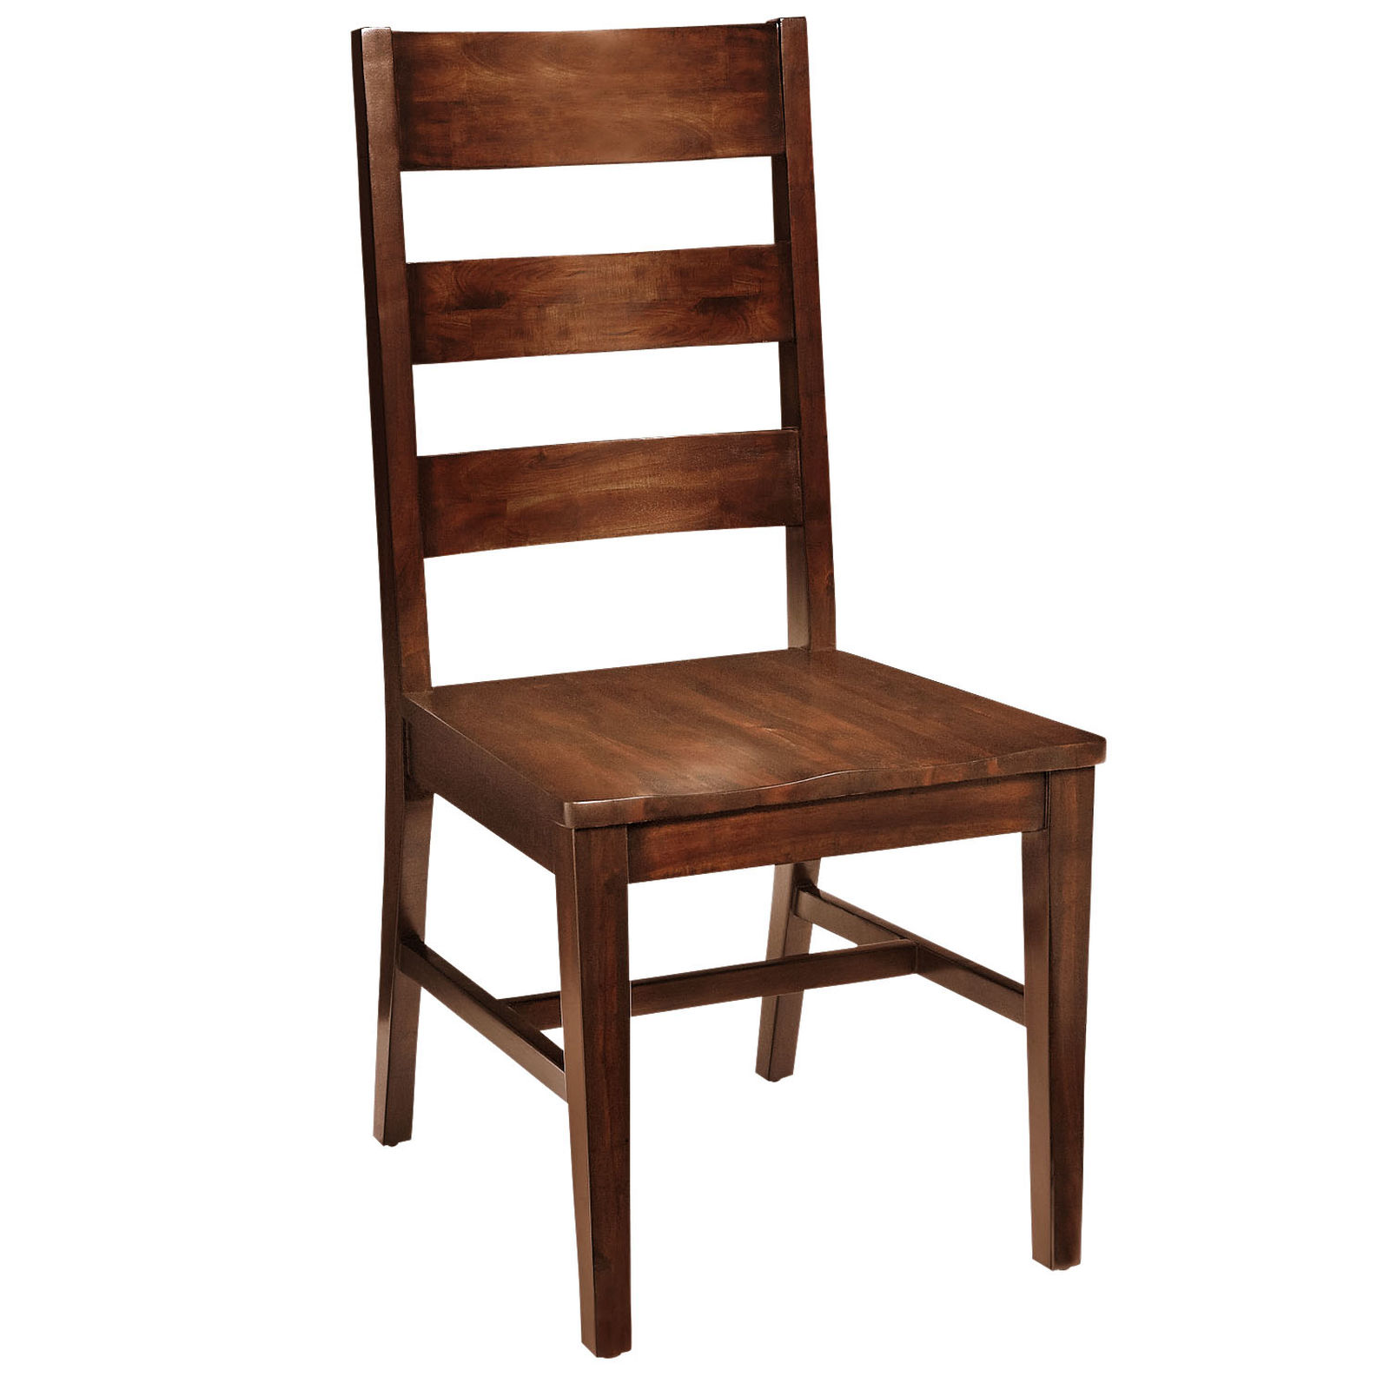

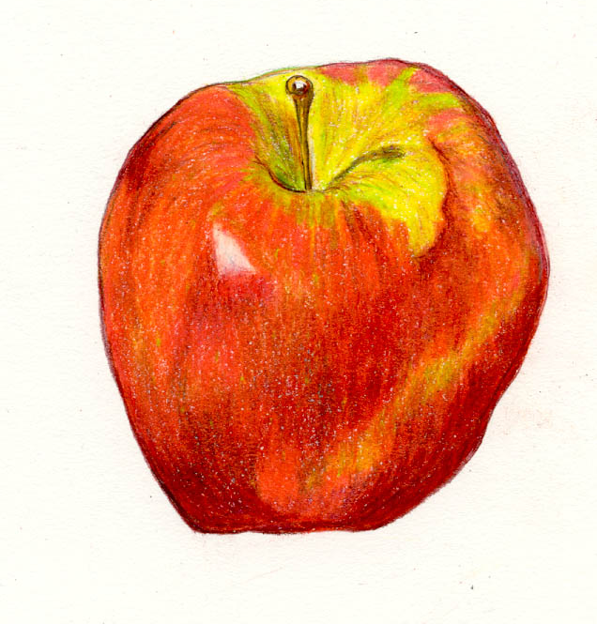


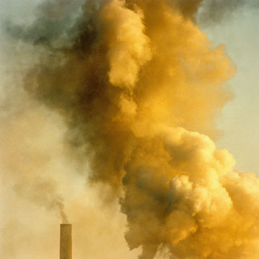
Speculating about Metaphors that motivate aspect
Spanish (Romance in general?)
Russian (Slavic in general?)
Perfective
Imperfective
Perfective
Imperfective

